Slide 1

HOTEL Recommender
IBM Capstone project.

Slide 2
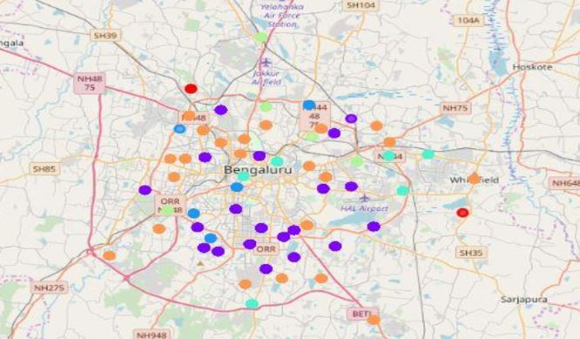
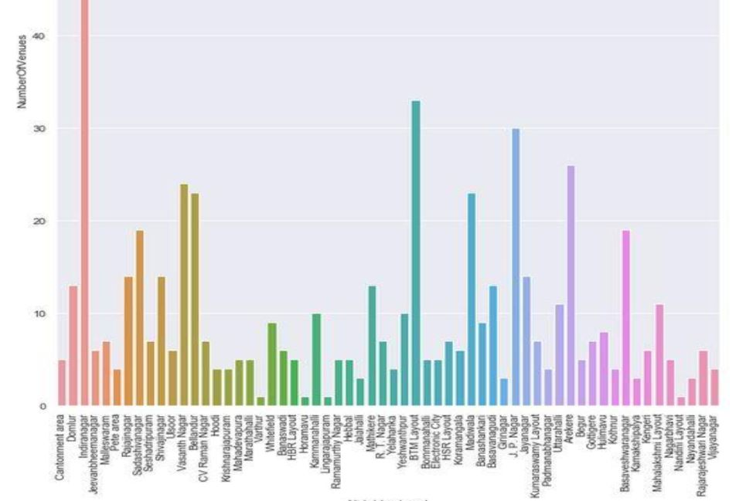
Methodology
Machine Learning
Exploratory Investigation
Inferential Outcome

Slide 3
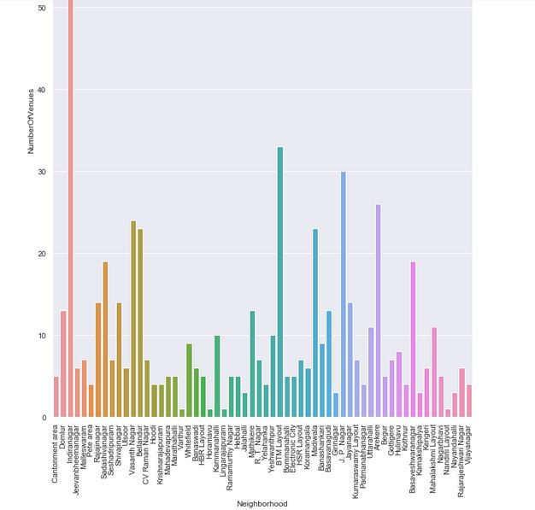
Insights

Slide 5
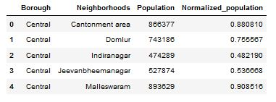

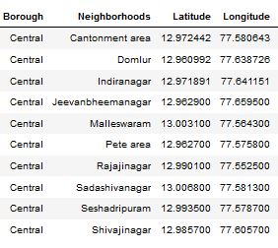
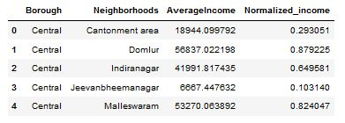
Datasets

Slide 6

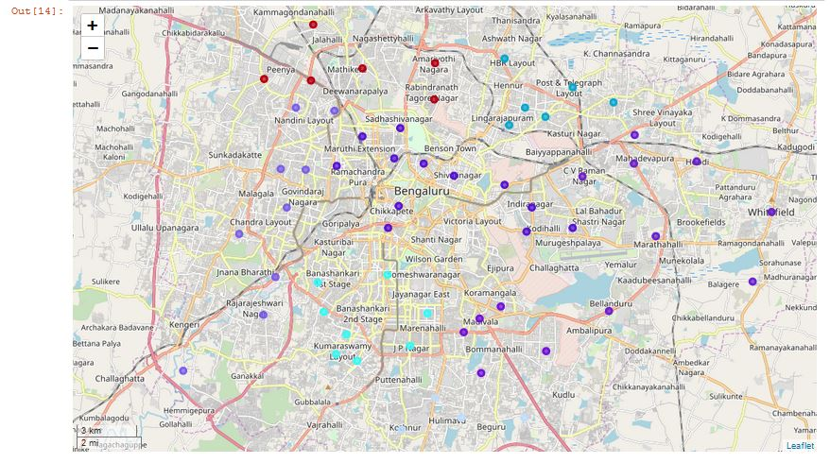
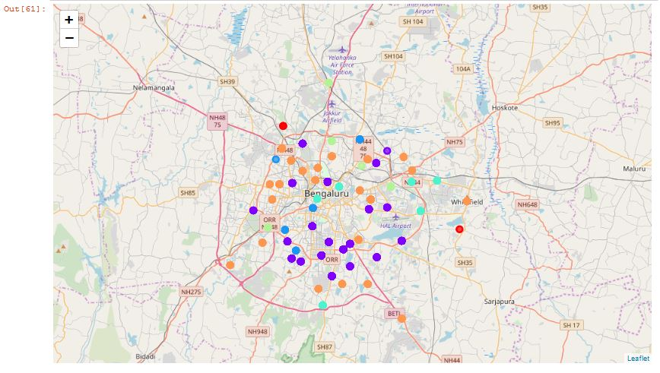
Mapping and clustering

Slide 7
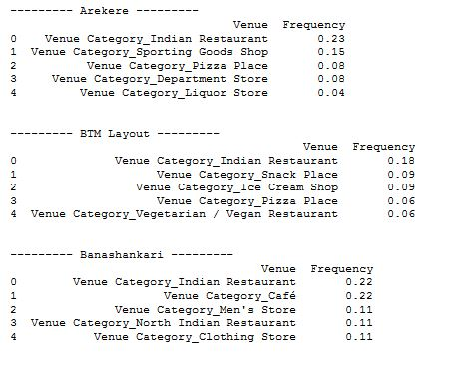

Results and conclusion

Slide 8

Thank You!
ksvhari007@gmail.com

